Slide 1


1. foundry
portfolio
portfolio

Slide 2
1.1 index
cpa

Slide 3

5.1 containers
V
1. new project
V
2. add dependencies
V
3. implement new task
V
4. deploy to local docker
V
5. deploy to azure
5.1.3 deploy to azure

Slide 4
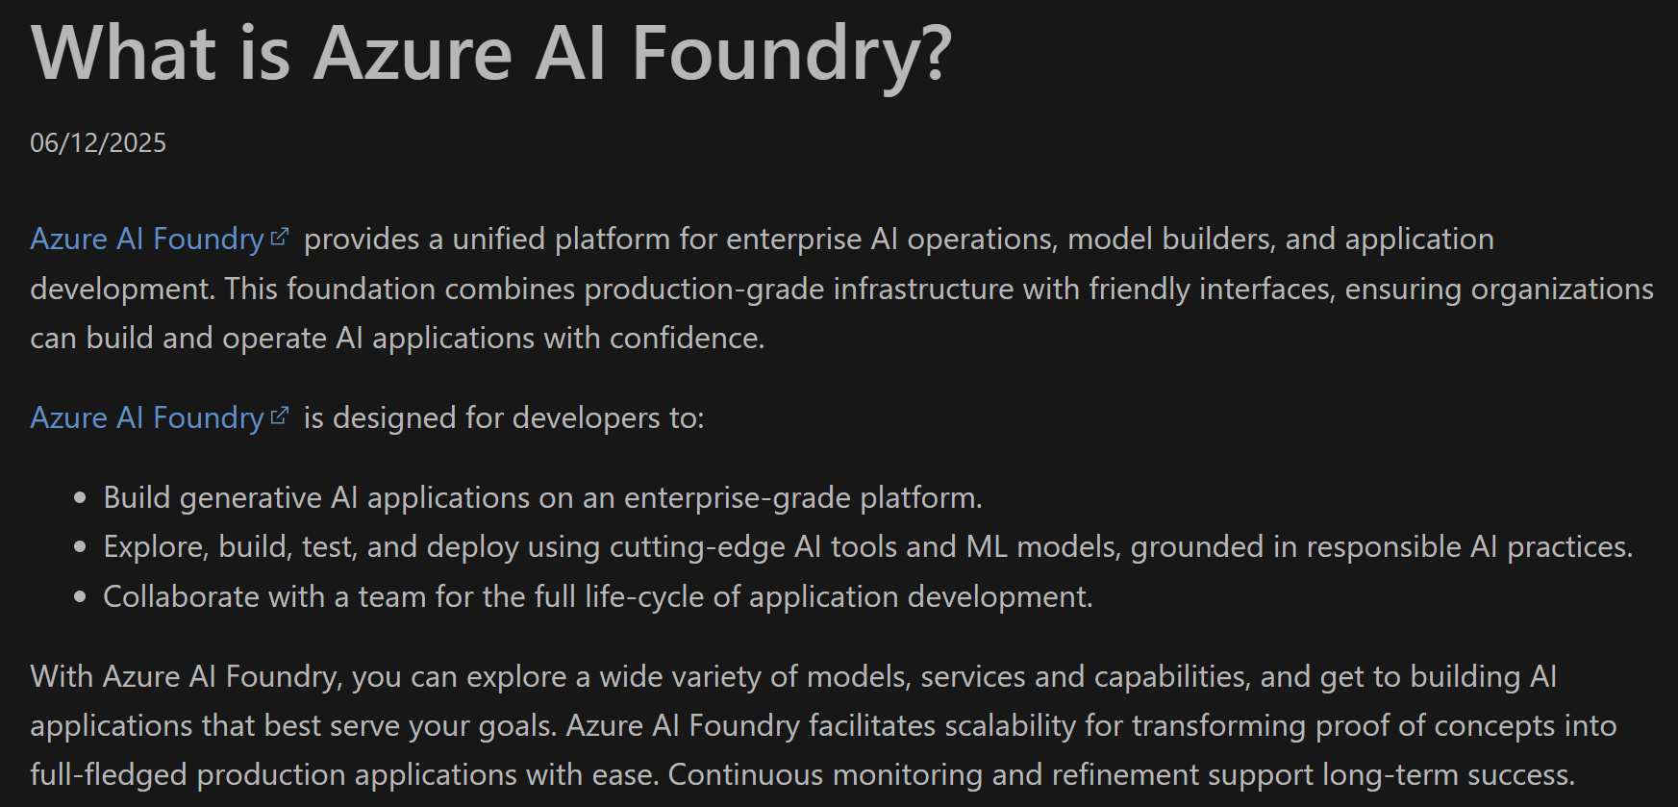

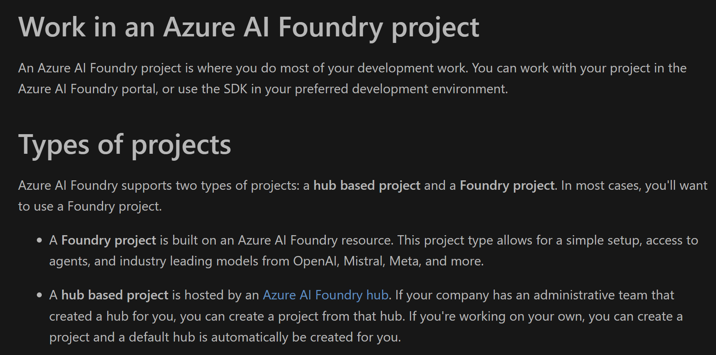
2. what
foundry
get started
what is foundry
projects
what is a project

Slide 5
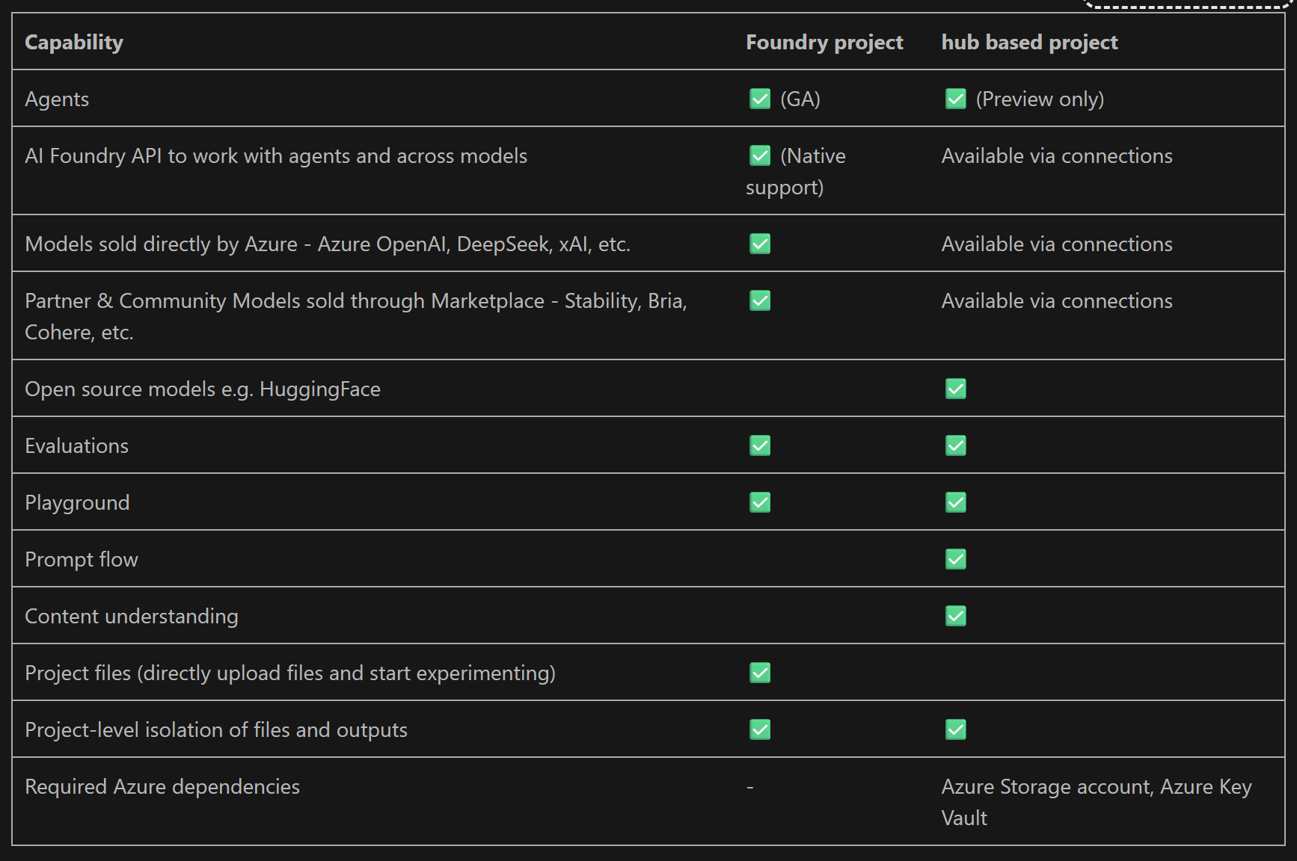
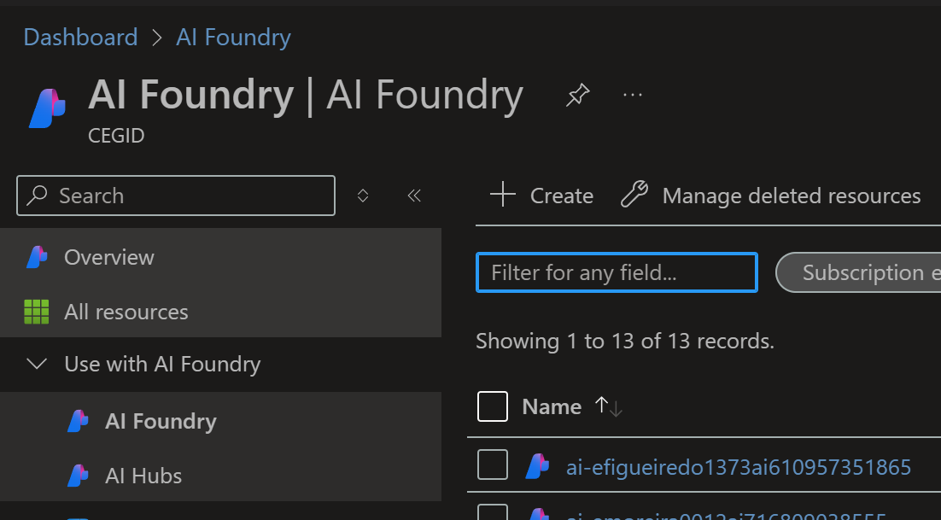
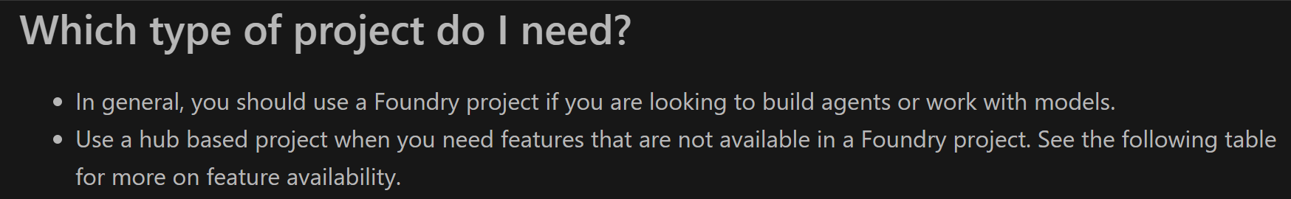
2.1 projects
types
project types

Slide 6
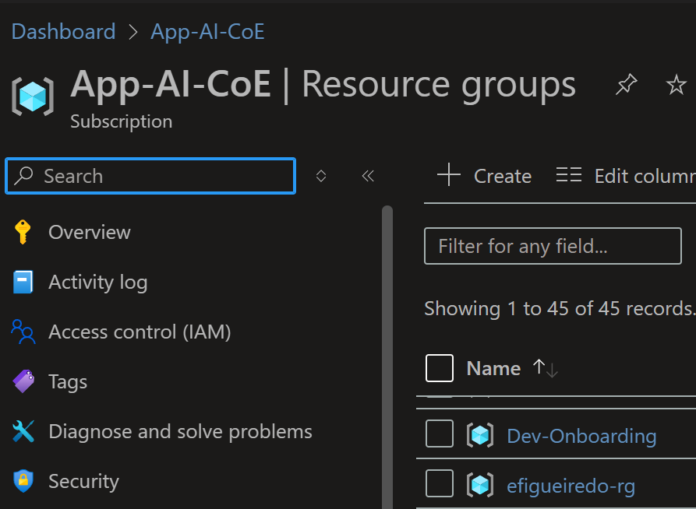
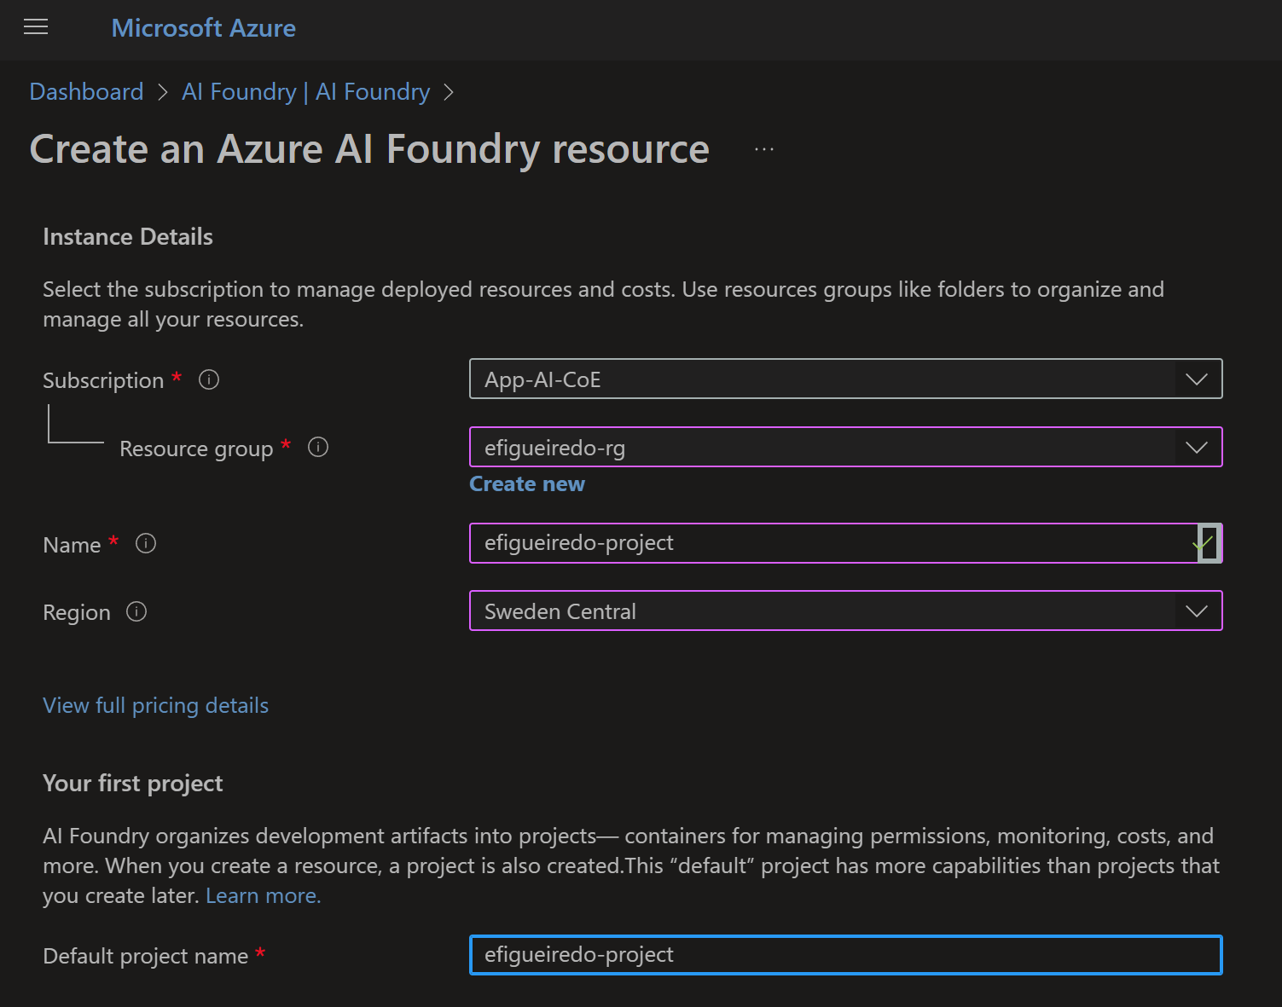
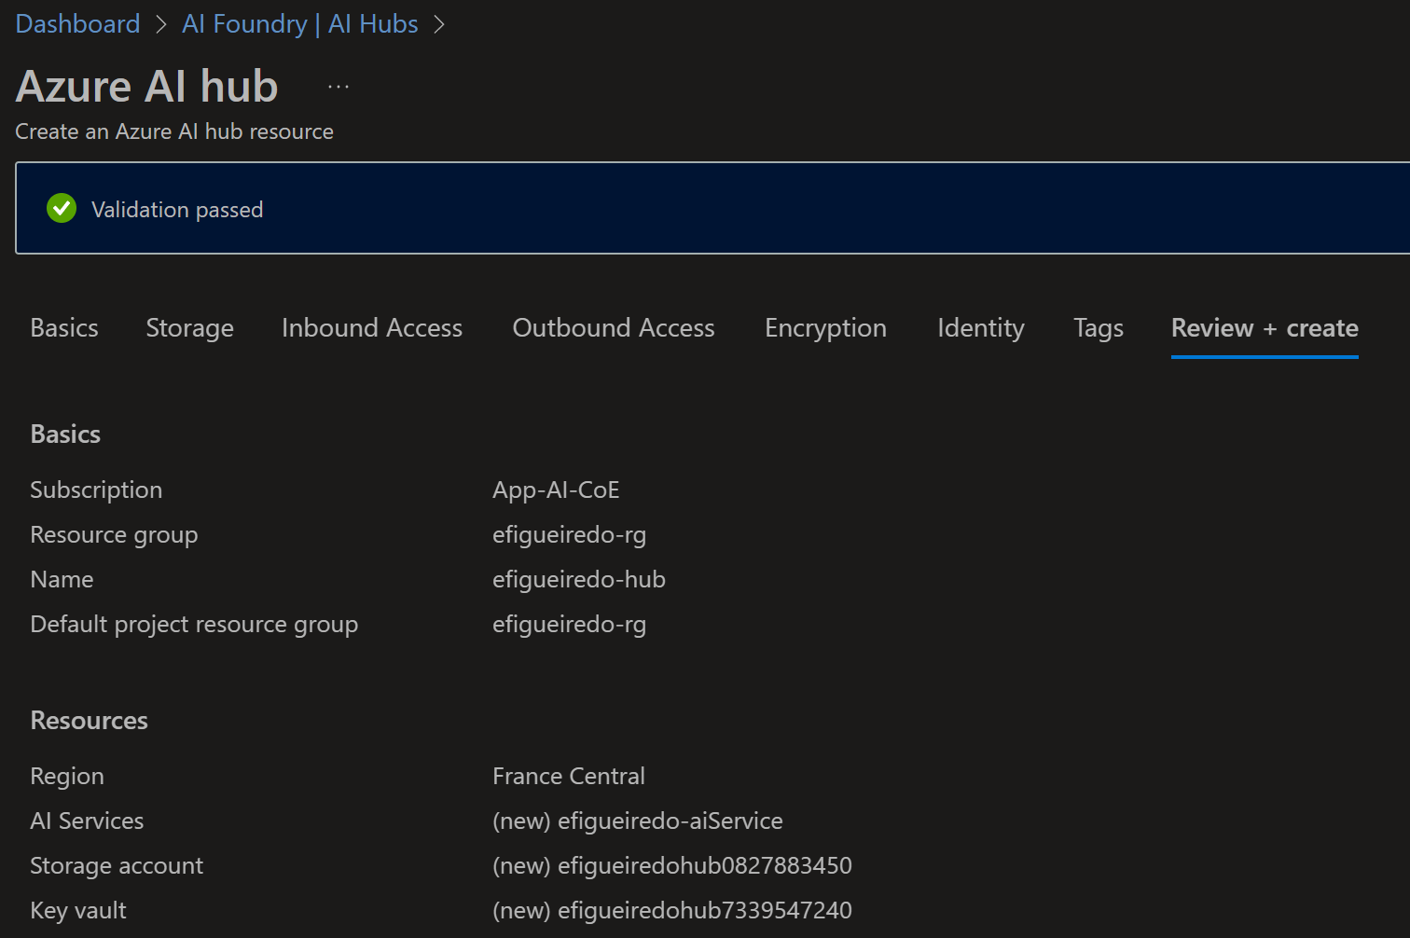
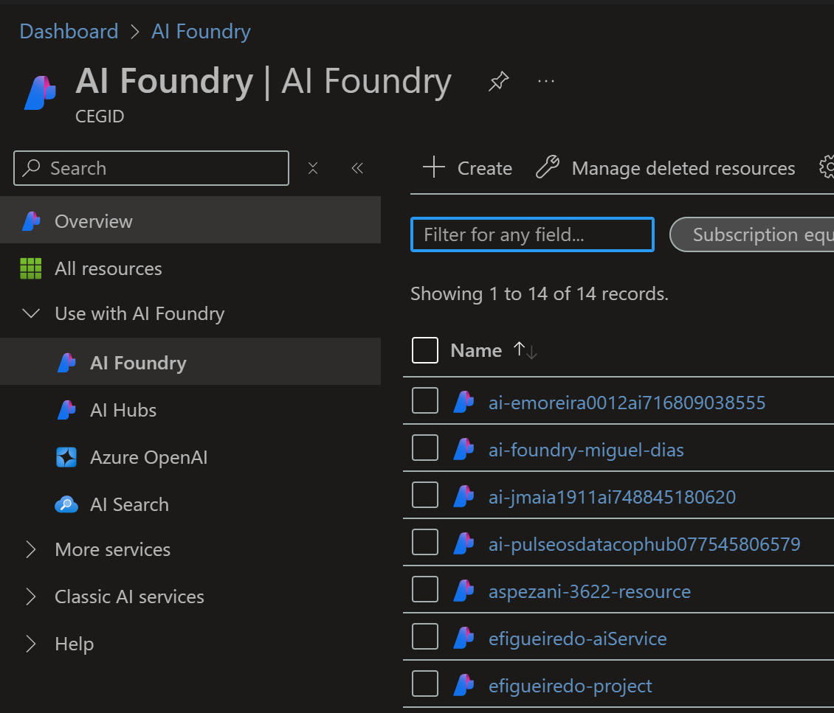
2.2 create
resource group
project
App-AI-CoE\resource groups
create hub
create project
create
  new
create Ai services

Slide 7
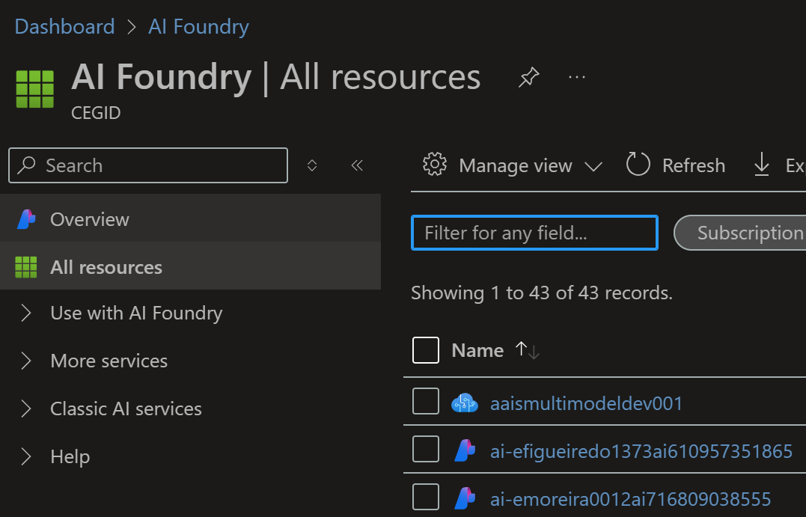
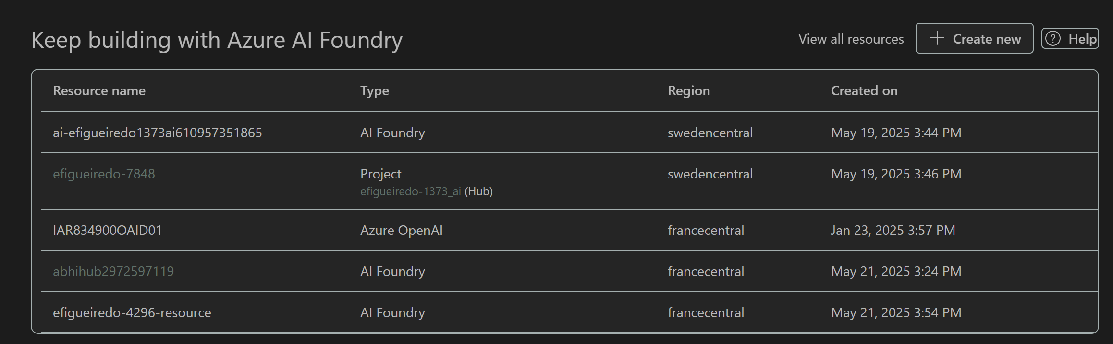
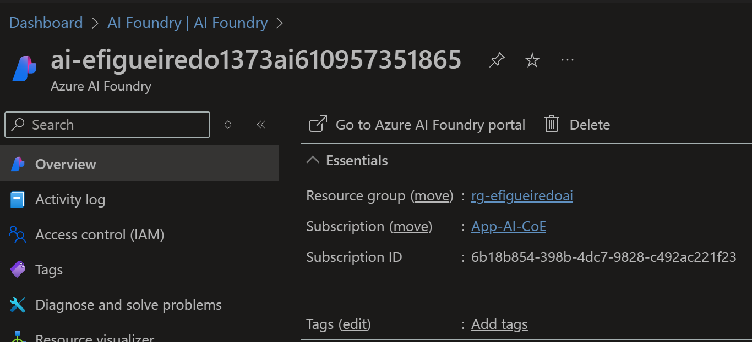
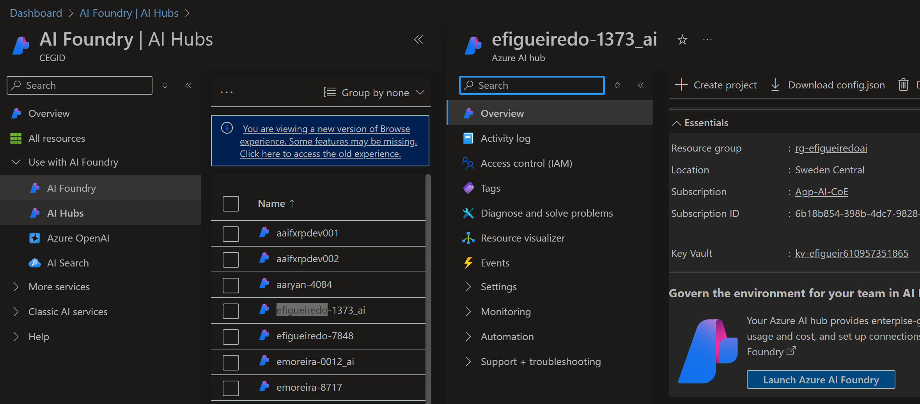
3. resources
azure
foundry
portal
foundry
project
hub

Slide 8
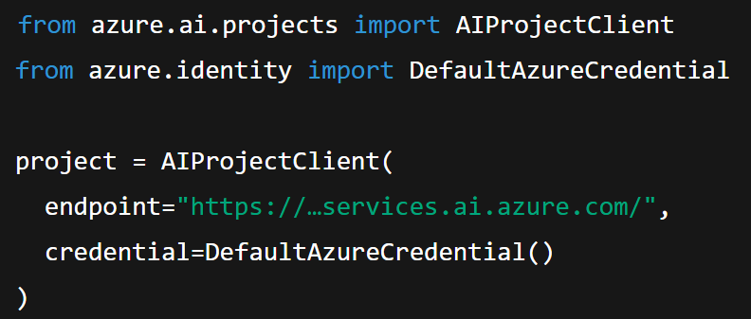
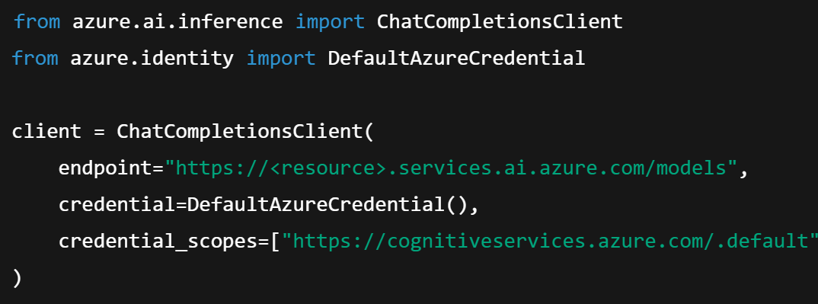
2. client
authentication
method | when | setup
DefaultAzureCredential | Local dev az CLI, managed identity, VS auth, etc. | auto‑detects environment document
AzureKeyCredential (API key) | simple key auth resource or Foundry key | just pass endpoint + key
Managed Identity / Entra ID | Secure production in Azure VMs, App Service, Functions | role assignment + key-less endpoint
chat gpt
client
projects
inference

Slide 9
4.1 hub

Slide 10

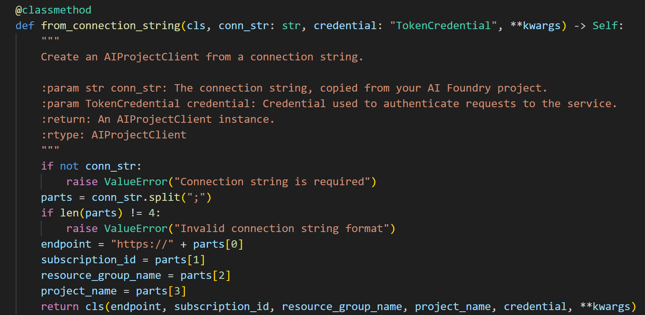
4.1.1 limitations
what
requires old version: b5
current: b11
it is just a wrapper
we can get
  the normal connection parameters
from the connection string
quick_start/creating-the-ai-project-client
lear/microsoft/ai_projects/overview

Slide 11
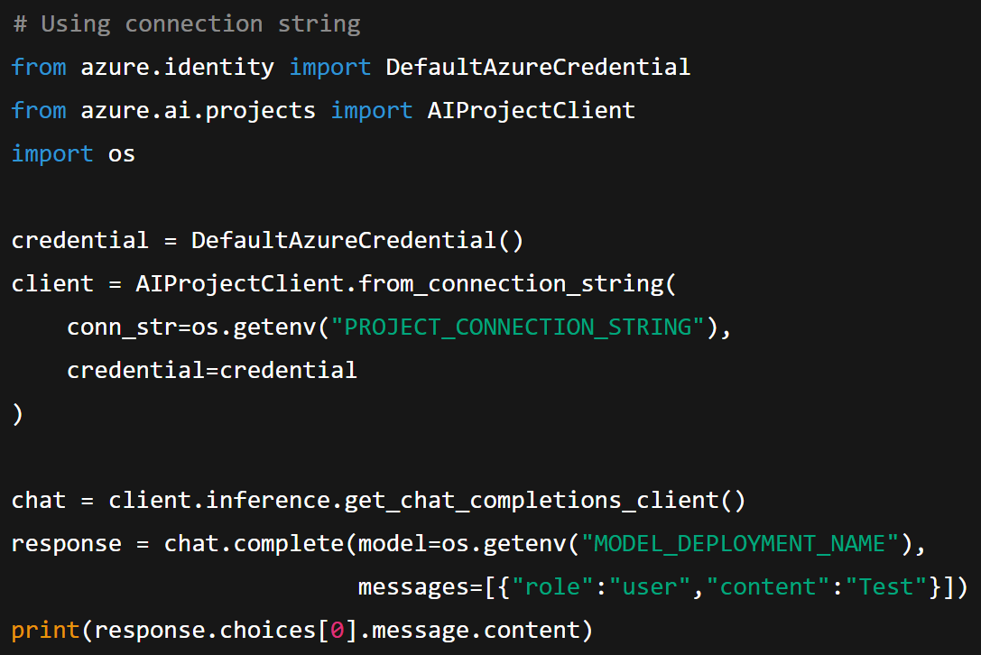
4.1.2 how
what
# Using connection string
from azure.identity import DefaultAzureCredential
from azure.ai.projects import AIProjectClient
import os
credential = DefaultAzureCredential()
client = AIProjectClient.from_connection_string(
conn_str=os.getenv("PROJECT_CONNECTION_STRING"),
credential=credential
)
chat = client.inference.get_chat_completions_client()
response = chat.complete(model=os.getenv("MODEL_DEPLOYMENT_NAME"),
messages=[{"role":"user","content":"Test"}])
print(response.choices[0].message.content)
chat gptconnection string
getting-started python sdk

Slide 12
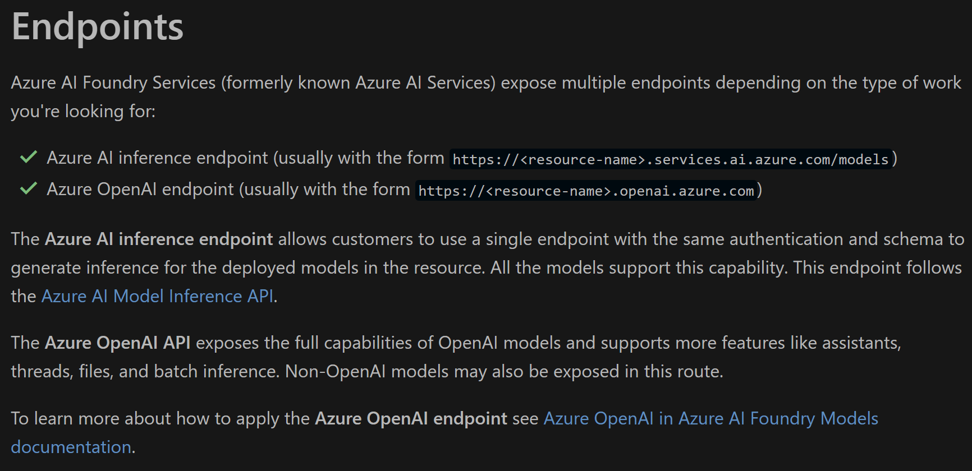
3. endpoints
what
azure foundry endpoints

Slide 13
3. inference
what

Slide 14



Z. template
new project
ExecuteAsync
square post-it
download
  exe
download
  exe
why
A slash
  followed
by
  two consecutive asterisks
D:\A1_research\C2_c0dice\B1_jmeter\A1_install
functionalities
introduction
build-exe
entity framework plus
zig help
⊂
4
every key-frame
defines the operation
success

